Slide 1
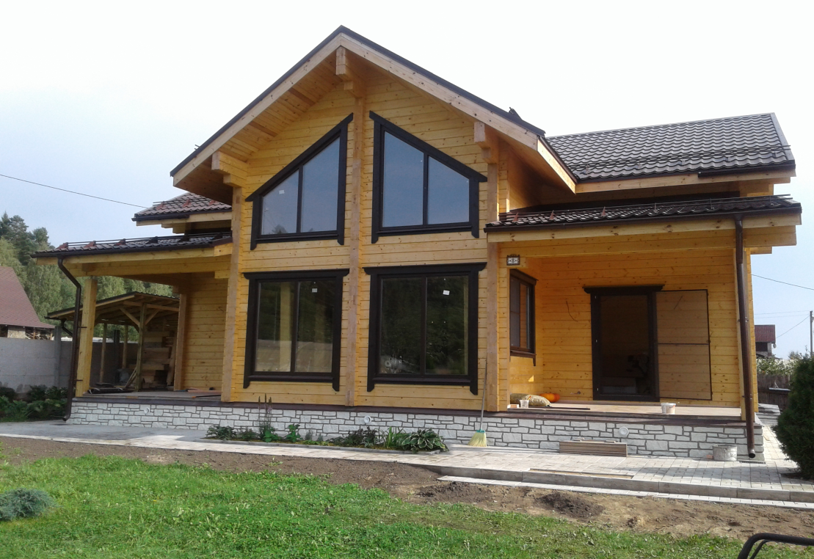
The Company «Adept-Les»

Slide 2
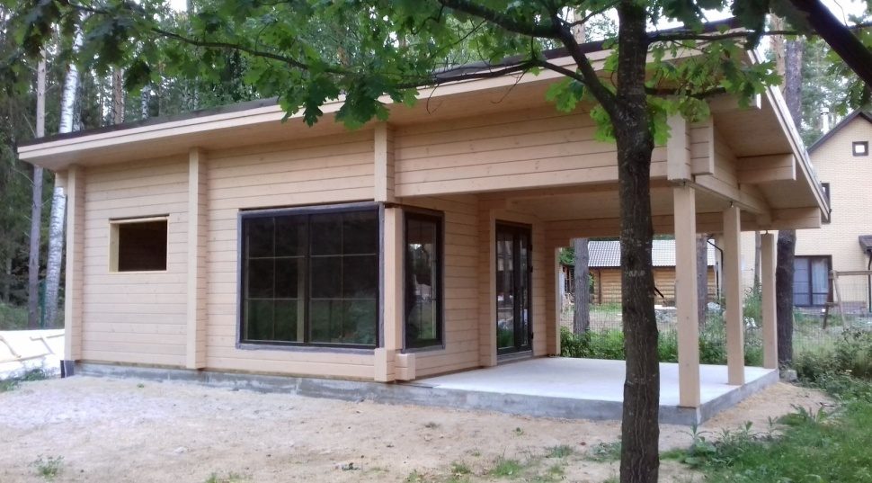
Company information
Field of activity: In 2008, the Company opened a glued laminated timber production workshop and purchased notching machines.
Number of years on the market, date of the company establishment: The Company "Adept-Les" was founded in 1995.
Company turnover: 2,000,000 Euros
Location of the head office and of the production facilities : Russia, Veliky Novgorod
Export share, export country: 3%, Germany, France.

Slide 3
Products
The Company's products can be divided into three categories:
1. Lumber using which Adept-Les builds the houses
2. “Housing kits” designed for permanent use, custom-tailored.
3. “Housing kits” for seasonal (spring-autumn) use and household buildings built according to the standard design.
Main properties:The house made of glued beams does not require internal and external finishing.
No shrinkage: The houses are built of laminated veneer lumber is practically not shrink and is suitable to move in immediately after construction.
Savings on the Foundation:
The house made of glued beams has a small weight so you do not need a strong Foundation.
Construction period:
your home comes from the factory almost ready. We build it as a constructor and build it in 30 days.
Energy saving:
A wall made of glued beams holds heat as well as almost 2 meters of brick wall. You save on heating.
House price:
thanks to unique technologies and fast Assembly, as well as minimal interior and exterior finishing, you can save money on construction. This house is 1.5 times cheaper than brick counterparts.
Description of the consumption segment Adept-Les gained the greatest experience in implementing projects of houses for permanent residence, from dry and glued laminated profiled timber in the North-West Region of Russia.
Logistics features: convenient location near Saint Petersburg

Slide 4
Commercial Proposal
Certificates: application of certified AkzoNobel glue
Price: 400 $/1 м3
Planned Deliveries: 500 m3 per month
Time frames: 1 month
The Company is supplied with modern equipment of well-known European brands:TRIMWEX (Czech Republic), WEINIG (Germany), MAKRON (Finland), KRUSI (Switzerland), LEDINEK (Slovenia) Experienced and highly qualified employees allow us to implement building projects from 5 to 1,000 m.

Slide 5
Contacs
"ADEPT-LES" LLC
19 Promyshlennaya Str., office 1, The Novgorod Region, the Novgorod district, Workers settlement of Pankovka, 173526, email: vn@adeptles.ru

